Slide 1


Slide 2
Skip Tutorial
Hello guys
Click to continue
Skip

Slide 3
Skip Tutorial
I’m sorry for not keeping developing
on Block Avoid.
Skip

Slide 4
Skip Tutorial
I lost my motivation, and
inspiration till I saw this one game...
Skip

Slide 5
Skip Tutorial
A game made in PowerPoint,
that is based on Undertale, but you control
as a cursor.
Skip

Slide 6
Skip Tutorial
The game is called Underpoint, and it
gave my inspiration back to making my
own game, in PowerPoint.
https://gamejolt.com/games/areweconnected/1007463
Skip

Slide 7
Skip Tutorial
Therefore, I wanted to start over
on my PowerPoint game, called Block Avoid,
and giving it a second chance.
Skip

Slide 8
Skip Tutorial
Without further ado,
let’s get into the game.
Skip

Slide 9


Slide 12
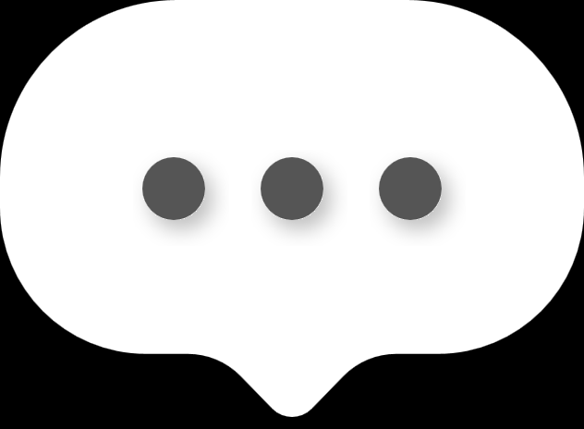

Blobby
Don’t worry, I can teach you!
Okay, there is some things, you may need to know.
Are you new here?
Hello! I’m Blobby!
Press here to start the tutorial

Slide 13
Once you are ready, click on the grey square to start
your training
Start Training
Okay, so I’ll teach the basics of the game

Slide 14
Tutorial

Slide 15

Click to continue
If you touch any Blocks...
you die.
Okay, so the rules for you is about
Avoiding the obstacles, and the Blocks

Slide 16
You can respawn by going to
the slide/level that you were at
Start Level
Yet of course...

Slide 17
Finish Level
Avoid the Blocks
Look out!!!

Slide 18

To try again, exit the slide show,
and select the level you were at.

Slide 19
Continue
Exit Slideshow

Slide 20


Block Avoid Music
Sound Effects
Block Avoid Intro
Figuate
New Game
Blobby Sound Effect
jsfxr
Tutorial
Game Over
Figuate (Undertale Sound Effects too)
Lo Res Font
Undertale & DELTARUNE Sound Effects
Toby Fox (Obviously)
Select Level
https://globalfonts.pro/font/lo-res
Are you ready to start
this adventure?
Level Complete
Figuate
Hard Boss Fight
Download this, and then restart the
slideshow to apply the font.
Special Thanks
Credits
Sprites for game
YOU FOR PLAYING!!! <3
Figuate
(c) 2025 Vivid Dreams. All rights reserved.
Fonts
Select if font isn’t pixelated
No
Yes
Back
Back
Back

Slide 21


The cursor got sent into
a very dark dimension, with no exit to be found.
Only left to be found, with an unlimited amount
of void to get lost in.
A random cursor
got sent into another dimension...
Once upon a time...
Reddoat
Evil Person
You probably wonder, where you are,
and why you are here.
I brought you here, because
I noticed you are more powerful, than anyone/anything in the universe
Yet not for long,
because you are about to lose that power.
Hello, my prisoner...
Wait. I MISSED?!?

Slide 22
We need to do this... the hard way.
I see.

Slide 23
Press Here to Start

Slide 24


!
Don’t touch the star.
Red is death.
14
Reddoat ran away
!
!
!
!
Click to attack
!

Slide 25
I will return.

Slide 26

Click here to continue, or hover.
A game
made in PowerPoint
By @FiguateNVC
Presents
A game made in a game engine
That is not supposed to work this good.
(Words by red_a)
SKIP

Slide 27
I may consider deleting
The tutorial from the game,
because it’s very inaccurate to the
changes actually happening to the game.
I think I’m gonna make the sprites for the game myself,
or get a friend to help me with it, but I promise I will make
some sprites.
Instead the game is actually gonna be like
Undertale (underpoint) where it’s like an
RPG, but you control the cursor as the player.
It was my plan to make the levels
Like in the tutorial, but it is not going to be
that way.
So, the first course you just saw
Was the first fight in the game.
Thank you for playing the early demo
of Block Avoid.
- Figuate, 2025

